Slide 1



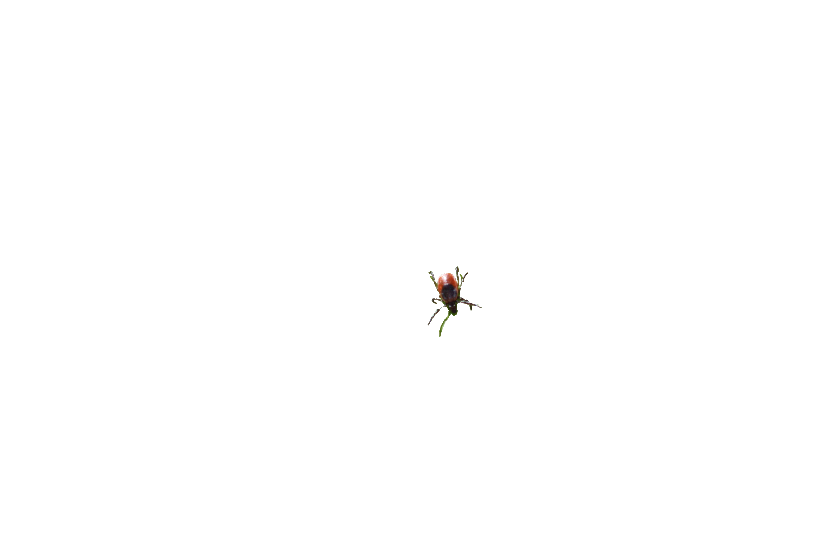

Virtual Town Hall: Preliminary Results 2020
Manisha Kulkarni, PhD; Roman McKay, PhD | School of Epidemiology & Public Health
med.uOttawa.ca
Notes:
PAGE COUVERTURE (option 1)
REMARQUE : À lire avant d’utiliser le gabarit
Les éléments suivants du gabarit ne peuvent pas être modifiés :
• En-tête institutionnel grenat (Université d’Ottawa | University of Ottawa)
• Pied de page institutionnel comprenant la bande grise et grenat ainsi que le logo
Les éléments suivants du gabarit peuvent être modifiés :
• L’adresse Web uOttawa.ca dans le pied de page peut être personnalisée afin de répondre aux besoins de l’utilisateur et le nom du document peut être inséré à la droite de l’URL si nécessaire. Vous pouvez simplement taper l’adresse Web désirée dans la boîte appropriée
• L’image ou la couleur de fond peut être remplacée par celle de votre choix
COVER PAGE (option 1)
NOTE: Read before using template
The following elements of the template must remain untouched and cannot be modified:
• Corporate (Université d'Ottawa | University of Ottawa) garnet header
• Corporate uOttawa footer including the grey/garnet stripe and logo
The following elements of the template may be customized:
• You may include the uOttawa.ca URL of your choice in the footer, and insert the name of the document to the right of the URL, if needed.
• The URL can be customized to a specific URL by following these simple steps: On the PowerPoint View tab, in the Master Views group, select Slide Master. Select the third slide on the left side panel, and type in the desired URL on the slide.
• The background image or colour may be replaced by the one of your choice

Slide 2
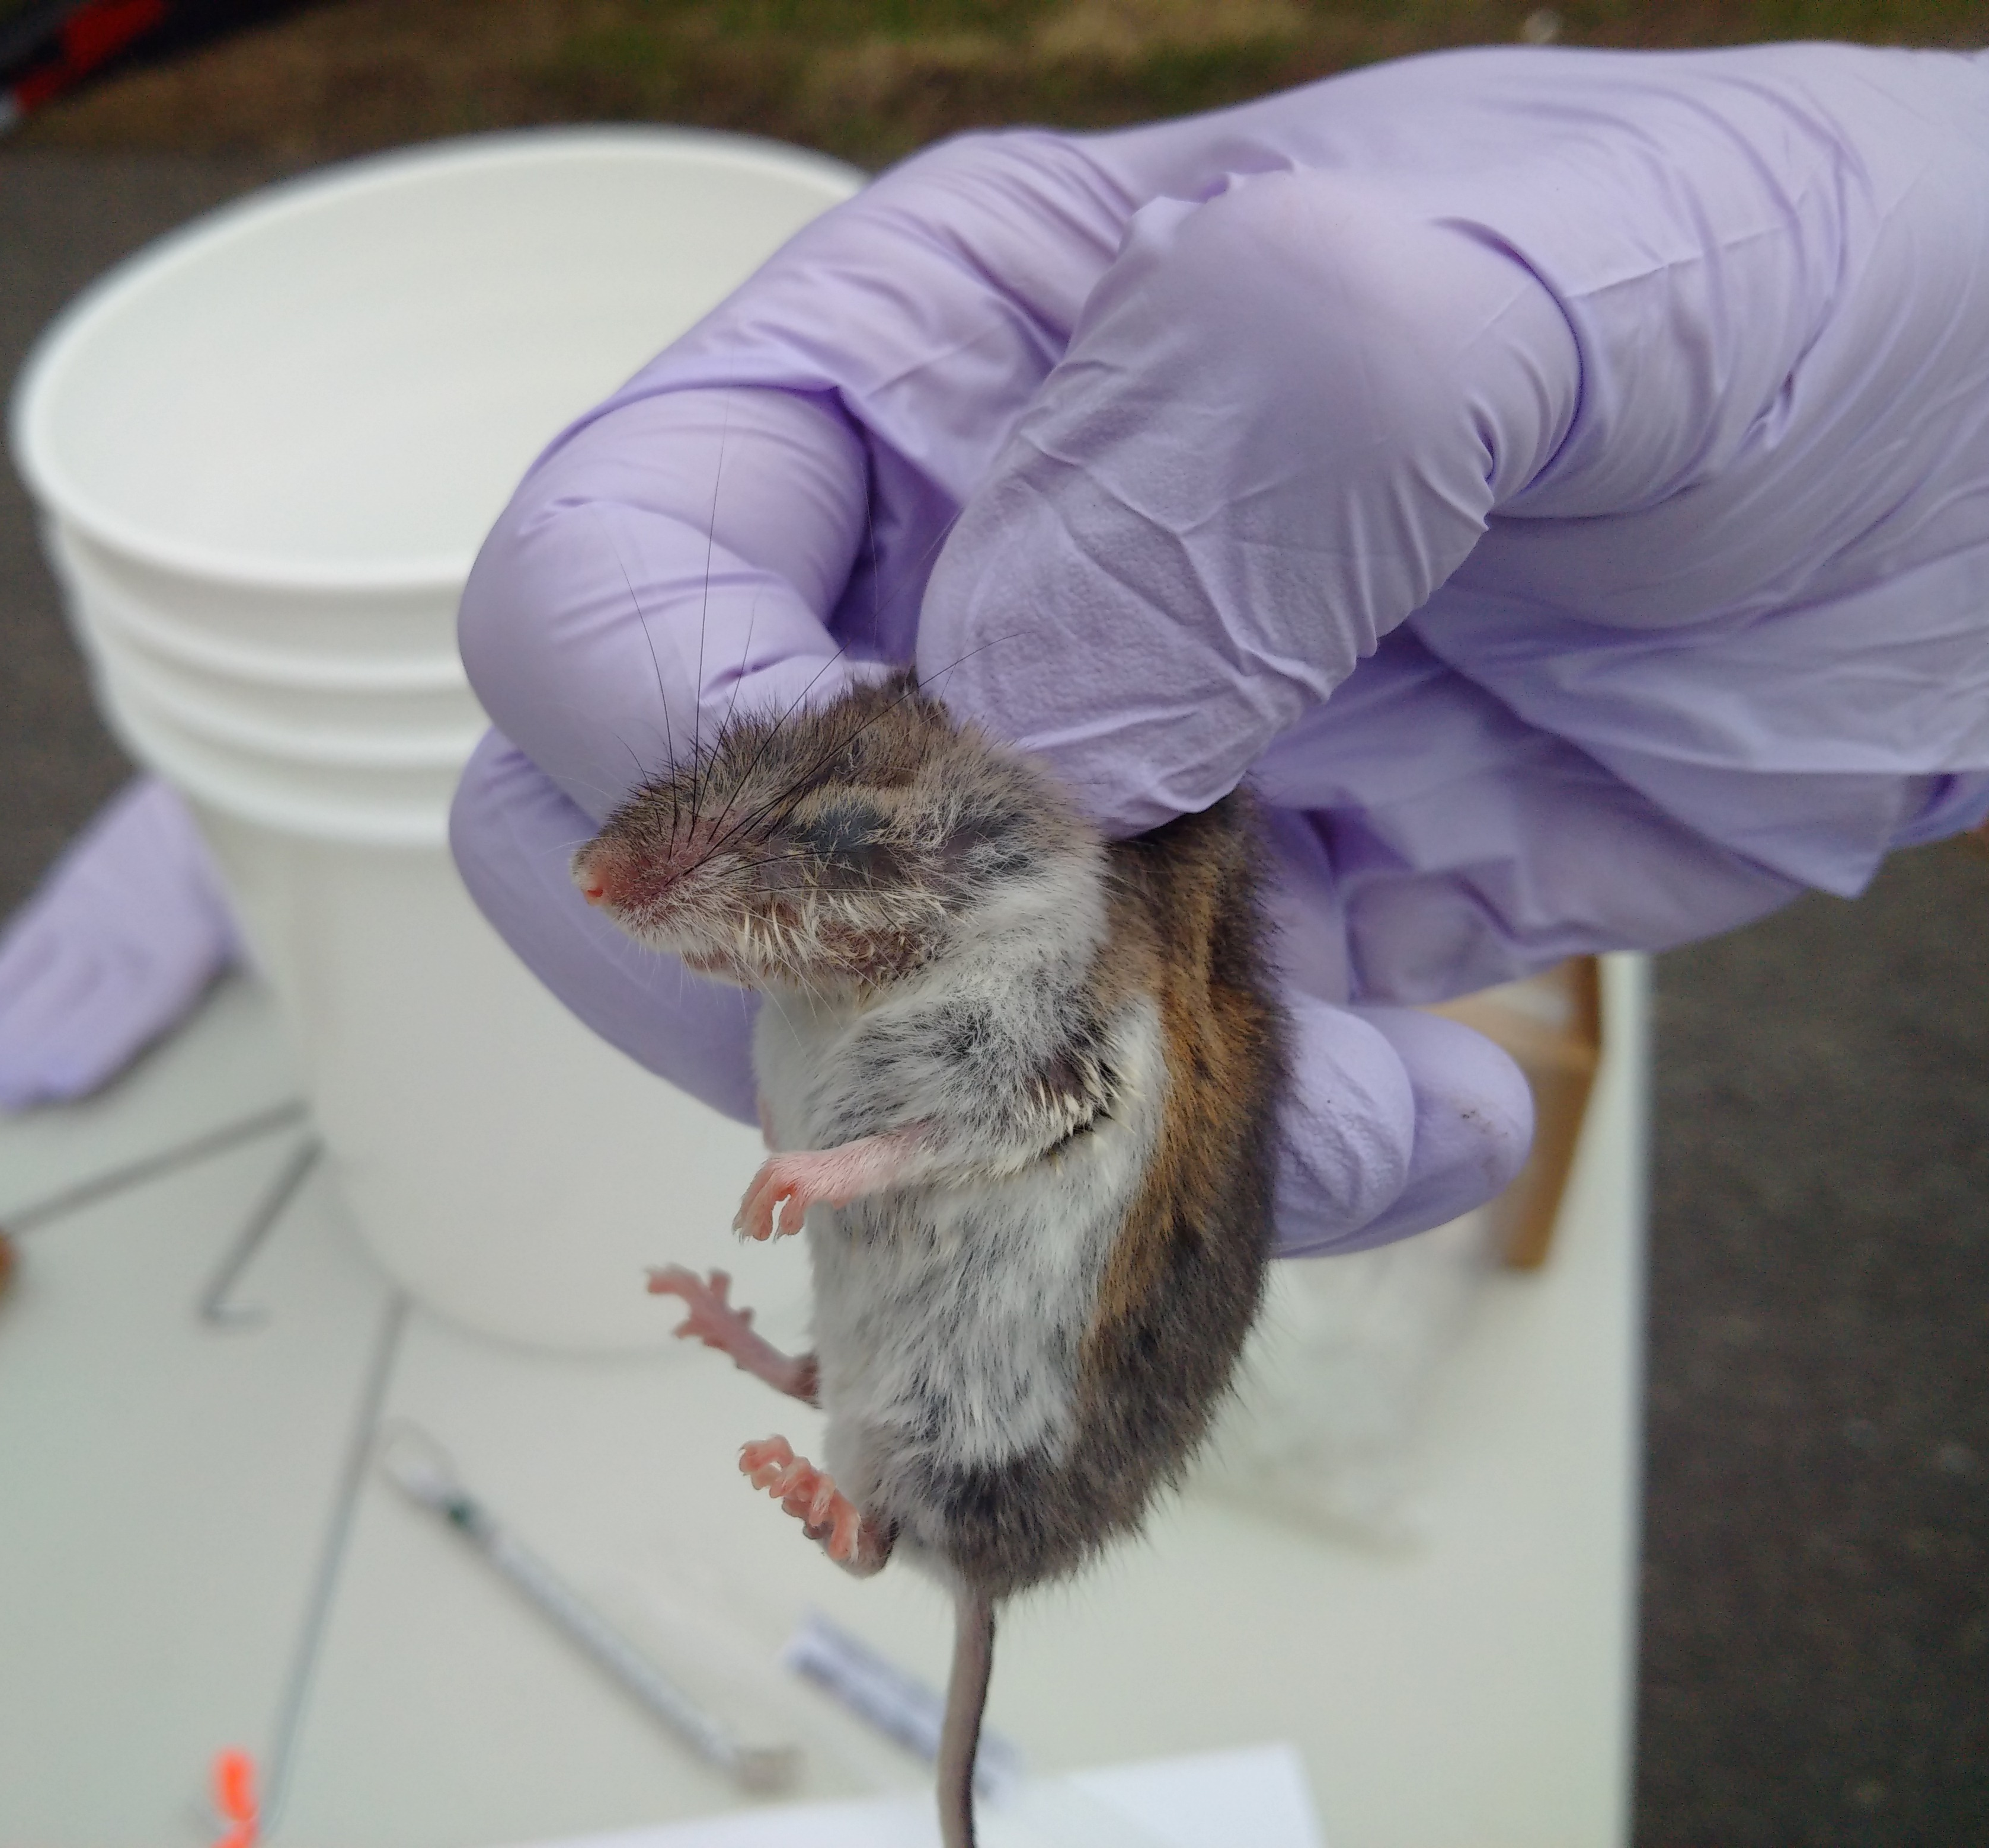
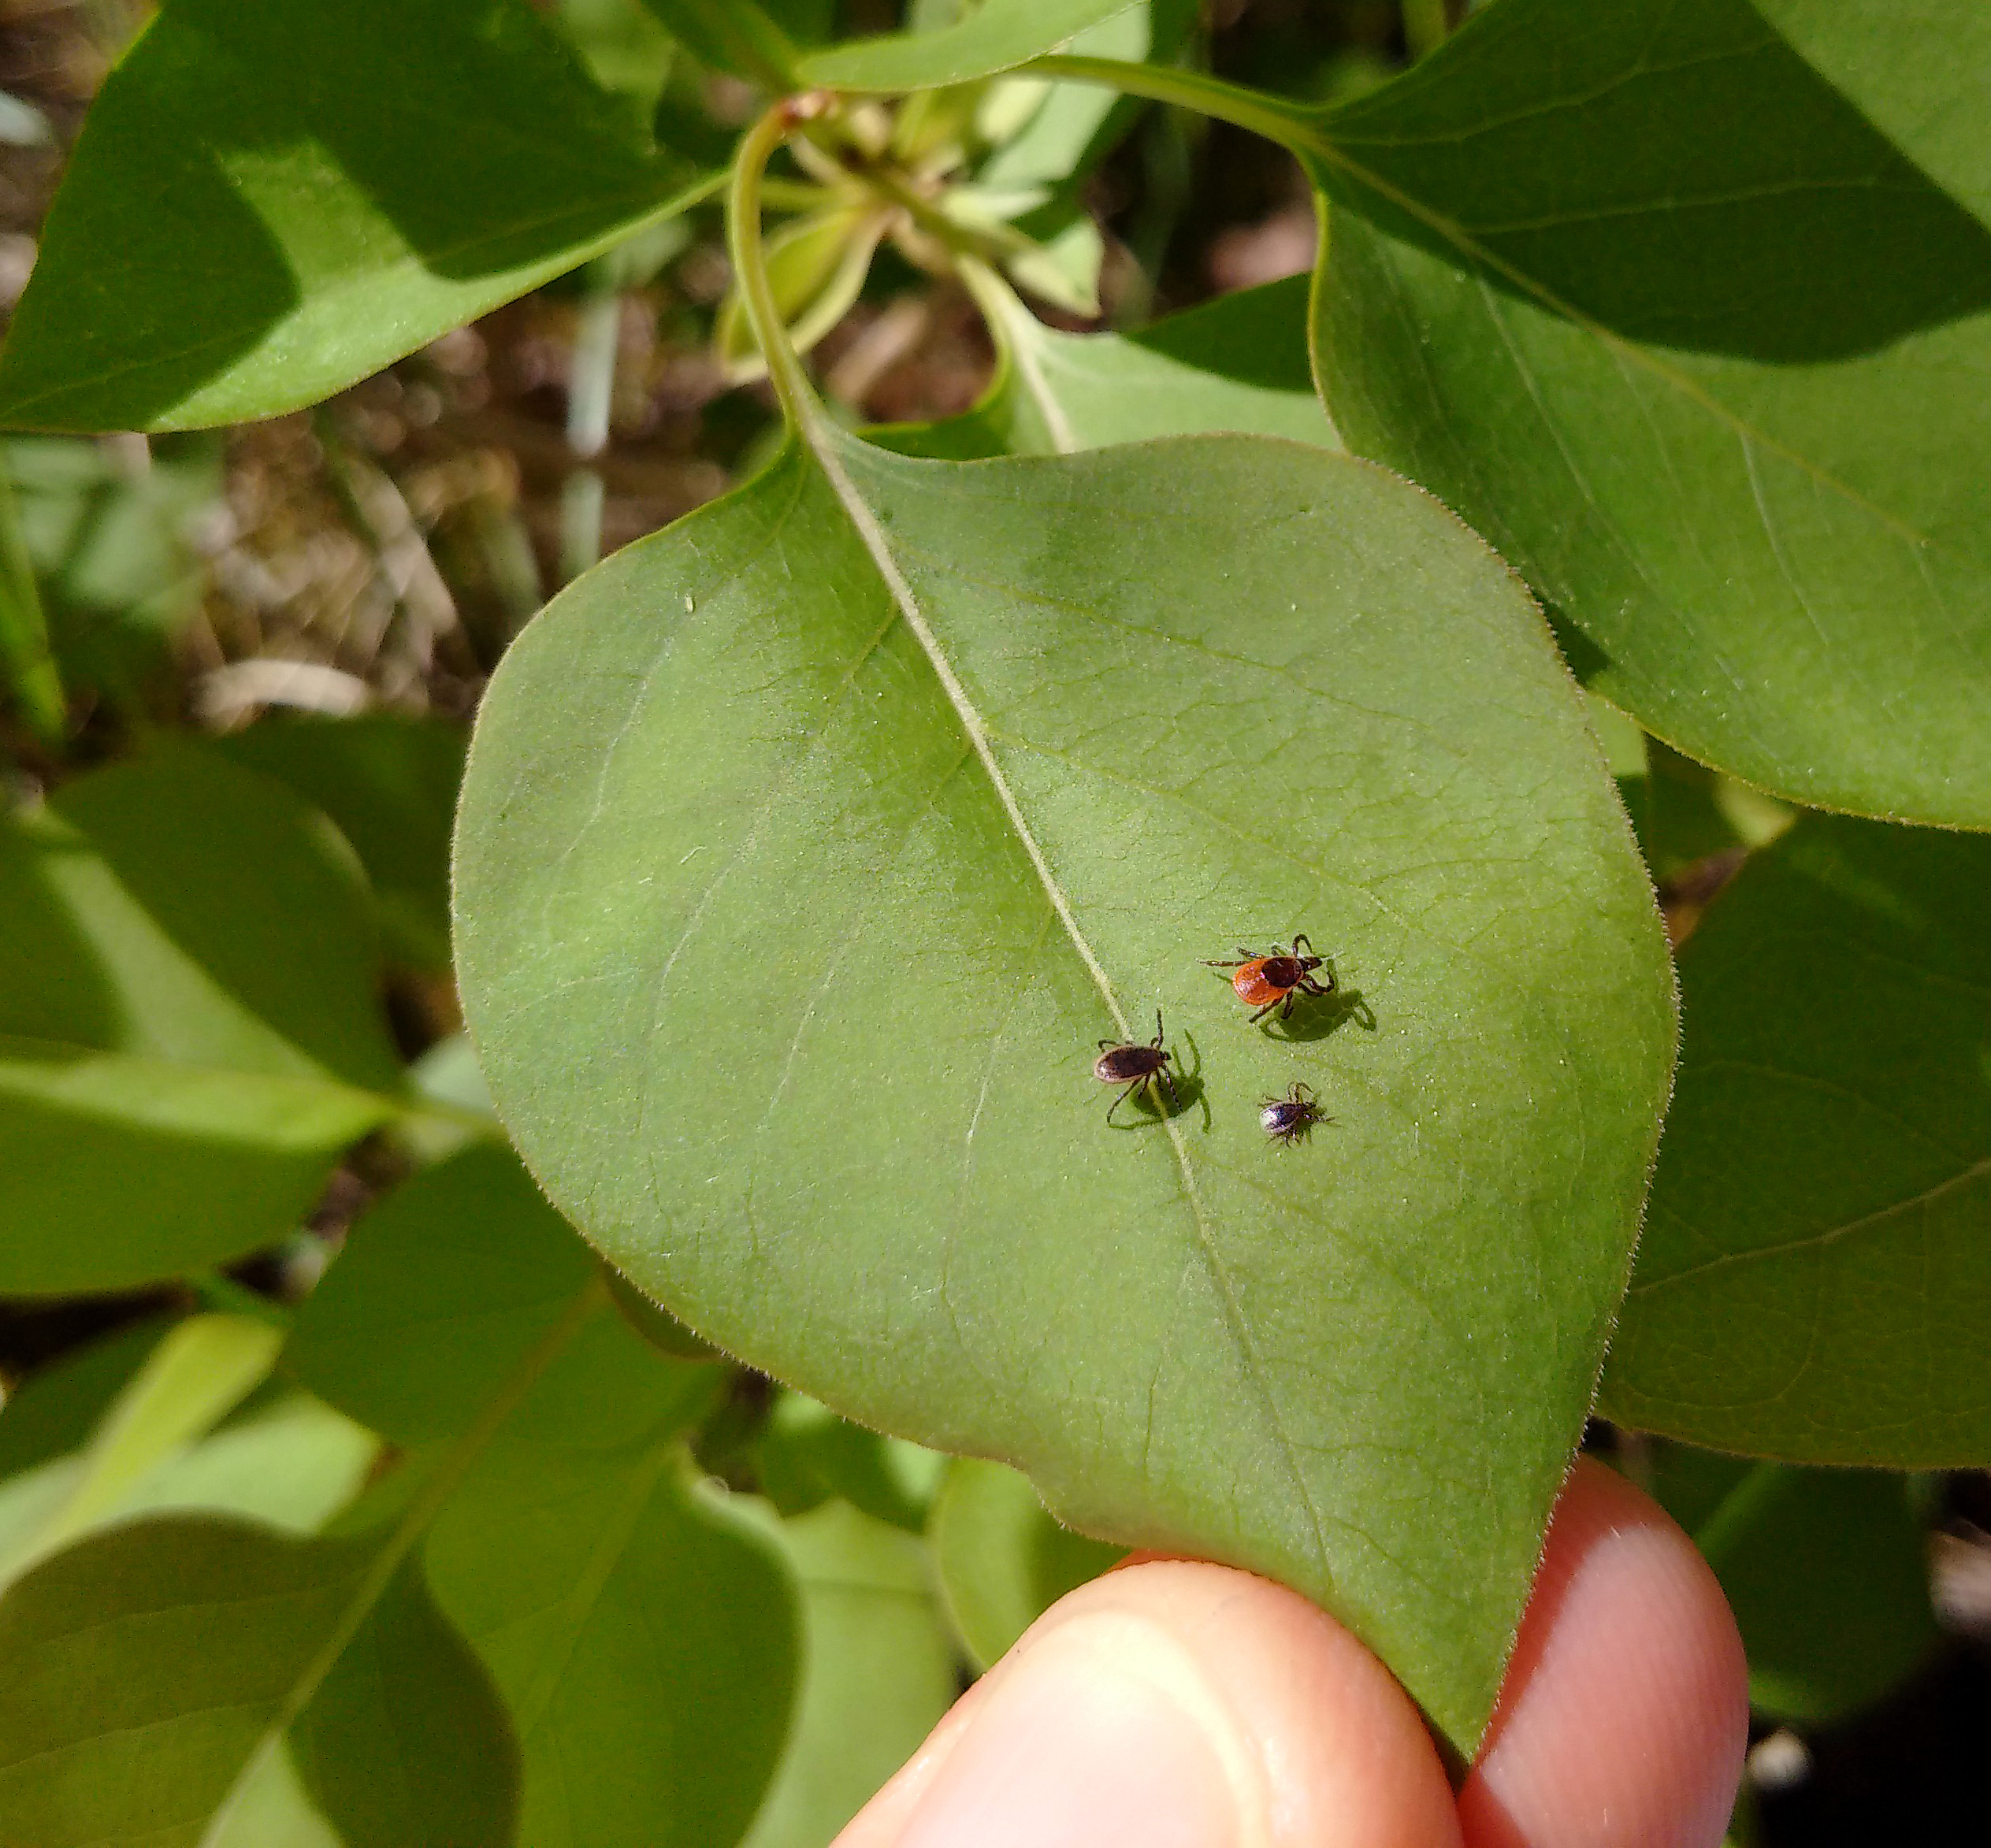
Outline
What is Lyme disease?
Why is it emerging in Ottawa?
UPTick research project
How can you prevent tick bites?

Slide 3
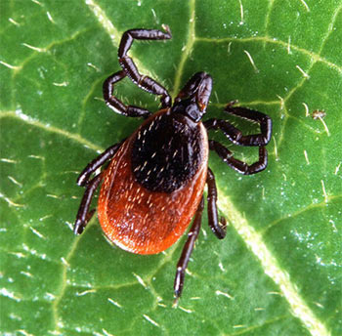
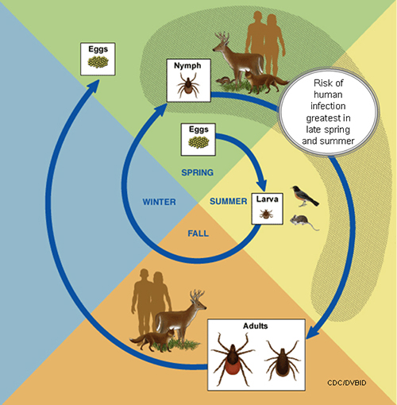
What is Lyme disease?
Tick-borne bacterial disease with rodent intermediate hosts
Blacklegged ticks (aka deer ticks) have a two-year life cycle with four life stages
Highest risk of human infection in late spring and summer months when nymphs are most active
Notes:
Lyme disease is caused by the bacterium Borrelia burgdorferi and transmitted by tick vectors, is the most commonly reported vector-borne disease in the temperate zone.
Ixodes scapularis, the blacklegged tick, is the main vector in eastern and central North America. Ixodes pacificus, the western blacklegged tick, is the main vector west of the Rocky Mountains. White-footed mice (Peromyscus leucopus) are considered the most competent reservoir for B burgdorferi (eastern chipmunks and shrews also competent hosts
Most humans are infected through the bites of immature ticks called nymphs. Nymphs are tiny (less than 2 mm) and difficult to see; they feed during the spring and summer months.
Adult ticks can also transmit Lyme disease bacteria, but they are much larger and are more likely to be discovered and removed before they have had time to transmit the bacteria. Adult Ixodes ticks are most active during the cooler months of the year.

Slide 4
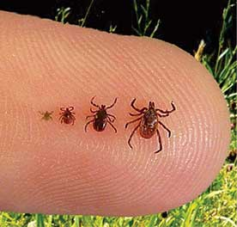
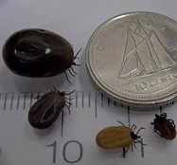
What are blacklegged ticks?
Mainly found in deciduous forests
Mainly found in areas with white-tailed deer
Cannot fly or jump
Ticks ‘quest’ on the tips of branches of low-growing shrubs or grasses and attach to hosts that brush by
PHAC 2018
Notes:
Nymphs are active May-August, and are most commonly found in moist leaf litter in wooded areas, or at the edge of wooded areas
Adult ticks are active October-May, as long as the daytime temperature remains above freezing. Preferring larger hosts, such as deer, adult blacklegged ticks can be found questing about knee-high on the tips of branches of low growing shrubs

Slide 5
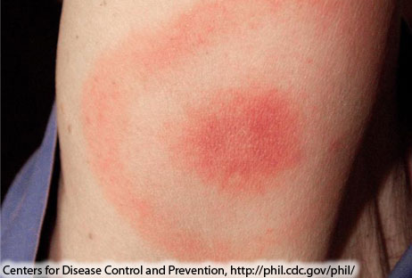
What is Lyme disease?
Bull’s eye rash occurs in about 70% of cases but may go unnoticed
People can be infected if they are bitten by a tick infected with Borrelia burgdorferi
Risk of infection following tick bite relates to how long tick has been attached (negligible risk if <24 hours)
Early symptoms can include fever, malaise, bull’s eye rash
If left untreated can cause neurological, arthritic and cardiac symptoms
Notes:
Symptoms:
Early localized disease (days to weeks): erythema migrans (EM) skin rash (occurs in 70% of cases), fever, headache, myalgia, joint symptoms
Disseminated and late disease (weeks to months): If untreated can lead to arthritis and neurological symptoms
A person has to be bitten by an infected tick to be at risk of Lyme, so it’s important to know where infected ticks occur
Risk is highest if the person was exposed to an area where ticks are endemic, and depends on the proportion of ticks that are infected
Even if they aren’t living in a Lyme risk or endemic area, people may be exposed in other areas of North America or Europe, so travel history is important, especially since diagnostic testing differs for NA vs EU strains
Data from the US suggest that the risk of infection followed by a tick bite in a Lyme endemic area ranges from 1-6%
But this also relates to how long the tick has been attached, with 36 hours needed for the tick to attach and the spirochetes to migrate to the salivary glands

Slide 6
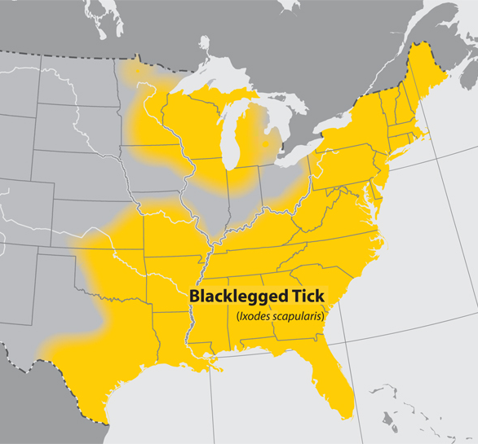
Why is Lyme disease emerging in Ottawa?
Warming temperatures permit expansion of tick vector geographic range into parts of Canada
Northward transport of ticks by migratory birds
Expanding range of white-footed mouse and white-tailed deer
Habitat fragmentation and biodiversity loss
Distribution of blacklegged ticks in the US (CDC)
Notes:
Previous slide shows predicted impact of climate change based on T limits for survival and development of tick vector
Transport of ticks by migratory birds is important for Lyme disease spread into Canada from US
Nymphal ticks are active in the NE US and southern Canada during spring migration
Nymphs feed for 4-5 days on their host, so migrating passerine birds, which travel approx 85 km/day, could potentially disperse ticks 400km or more northwards
Other drivers include the expanding range of the white footed mouse and while tailed deer, bring driven in part by climate but also by habitat fragmentation and biodiversity loss

Slide 7
Where does Lyme disease risk occur?
Public Health Ontario (2021)
Notes:
At the provincial level -- Ontario…
PHO defines a Lyme disease risk area in Ontario based on active tick surveillance (ie conducting three person-hours of drag sampling of areas of concern between May and October), since finding at least one blacklegged tick (Ixodes scapularis) during this time period may indicate a possible risk area for Lyme disease.
The estimated risk areas are calculated as a 20 kilometer radius from the centre of a location where blacklegged ticks were found through drag sampling.
According to PHO this map of Lyme disease Risk Areas has been developed to assist clinicians in the diagnosis and/or treatment of Lyme disease, with potential exposures or tick bites in the risk areas delineated on the map leading to greater concern about the risks of Lyme disease. In addition, public health professionals can use the map to determine if reported case exposure locations represent known or possible new/emerging risk areas, thus helping to inform public health messages aiming to raise awareness of Lyme disease risk areas in Ontario.

Slide 8
Why are we doing research in Ottawa?
* reflects exposure within and outside the City of Ottawa
** 2019 Cases (Q1, Q2 and Q3)
Data source: http://www.ottawapublichealth.ca/en/reports-research-and-statistics/infectious-diseases.aspx#cases

Slide 9
UPTick project is a three-year study to enhance our understanding of how urban changes affect human risk from Lyme and other tick-borne diseases.
The aim is to monitor ticks and tick-borne pathogens in peri-urban settings to better understand the drivers of human risk for tick-borne diseases, and inform mitigation strategies.
Funding support from the Public Health Agency of Canada (PHAC) Infectious Disease and Climate Change Fund (IDCCF), 2019-2022
“Best practices for urban planning in the context of climate change and emerging tick-borne diseases”
Notes:
At the provincial level -- Ontario…
PHO defines a Lyme disease risk area in Ontario based on active tick surveillance (ie conducting three person-hours of drag sampling of areas of concern between May and October), since finding at least one blacklegged tick (Ixodes scapularis) during this time period may indicate a possible risk area for Lyme disease.
The estimated risk areas are calculated as a 20 kilometer radius from the centre of a location where blacklegged ticks were found through drag sampling.
According to PHO this map of Lyme disease Risk Areas has been developed to assist clinicians in the diagnosis and/or treatment of Lyme disease, with potential exposures or tick bites in the risk areas delineated on the map leading to greater concern about the risks of Lyme disease. In addition, public health professionals can use the map to determine if reported case exposure locations represent known or possible new/emerging risk areas, thus helping to inform public health messages aiming to raise awareness of Lyme disease risk areas in Ontario.

Slide 10
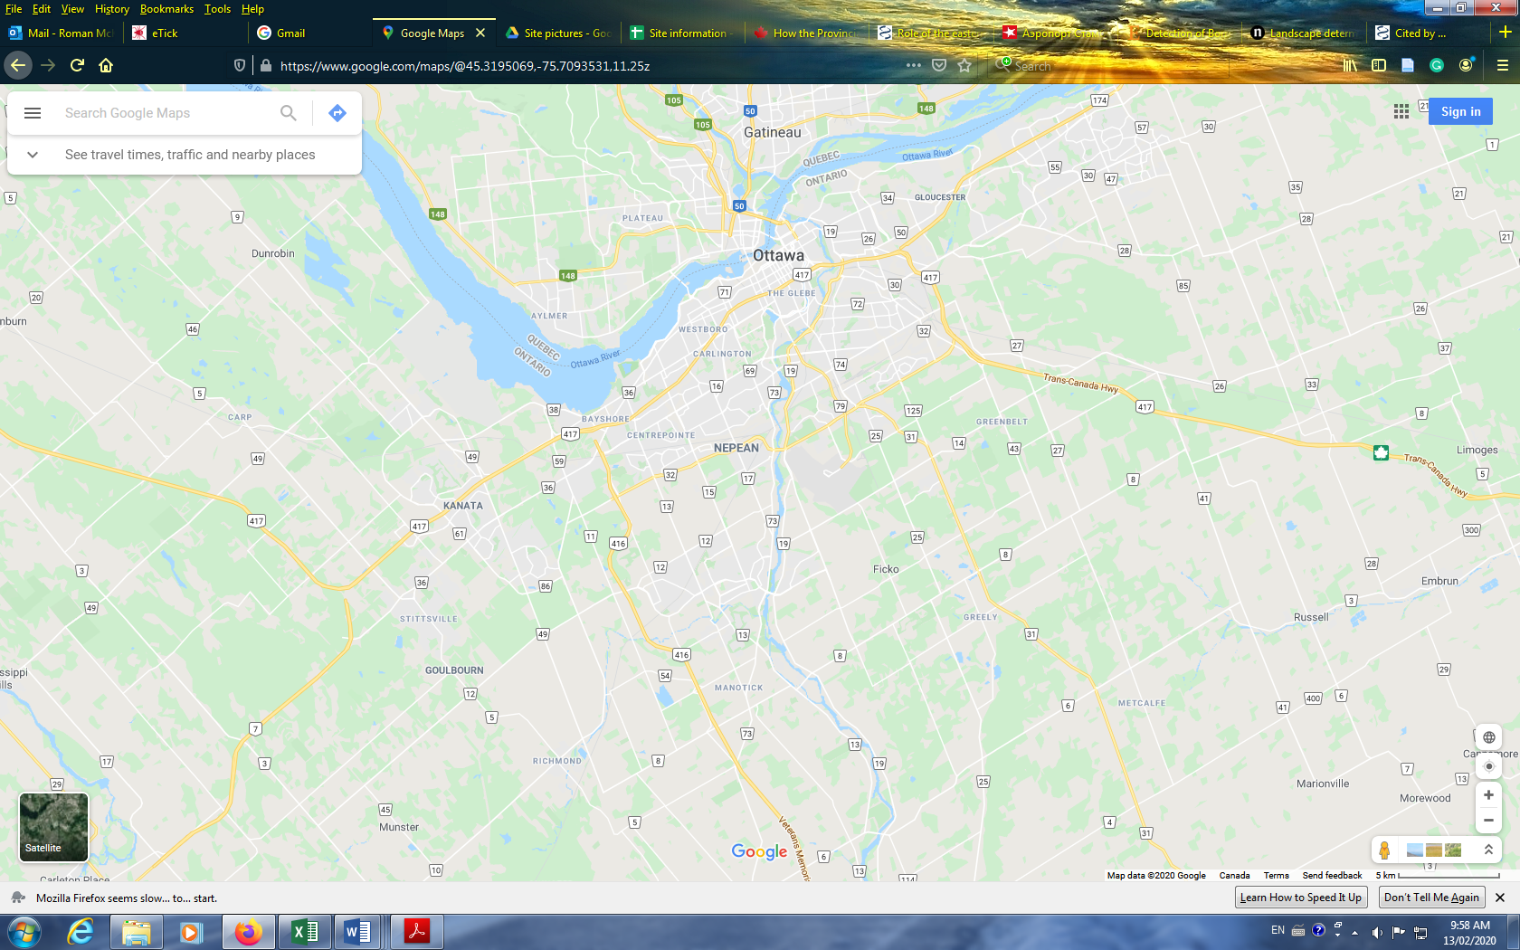
Study area
In each neighbourhood we sampled three zones: woodland (W), interface (I) and residential (R) zones.
Woodland zone - natural wooded area
Interface zone - established residential/woodland interface
Residential zone - within-neighbourhood pathways and trails
4
1
2
3
Map: Ottawa area with 4 sentinel neighborhoods:
Kanata North (Kizell Pond);
Kanata South (Stonehaven neighborhood);
Stittsville – Upper Poole Creek corridor; and
Carp Hill (Wetland Complex).
Notes:
At the provincial level -- Ontario…
PHO defines a Lyme disease risk area in Ontario based on active tick surveillance (ie conducting three person-hours of drag sampling of areas of concern between May and October), since finding at least one blacklegged tick (Ixodes scapularis) during this time period may indicate a possible risk area for Lyme disease.
The estimated risk areas are calculated as a 20 kilometer radius from the centre of a location where blacklegged ticks were found through drag sampling.
According to PHO this map of Lyme disease Risk Areas has been developed to assist clinicians in the diagnosis and/or treatment of Lyme disease, with potential exposures or tick bites in the risk areas delineated on the map leading to greater concern about the risks of Lyme disease. In addition, public health professionals can use the map to determine if reported case exposure locations represent known or possible new/emerging risk areas, thus helping to inform public health messages aiming to raise awareness of Lyme disease risk areas in Ontario.

Slide 11
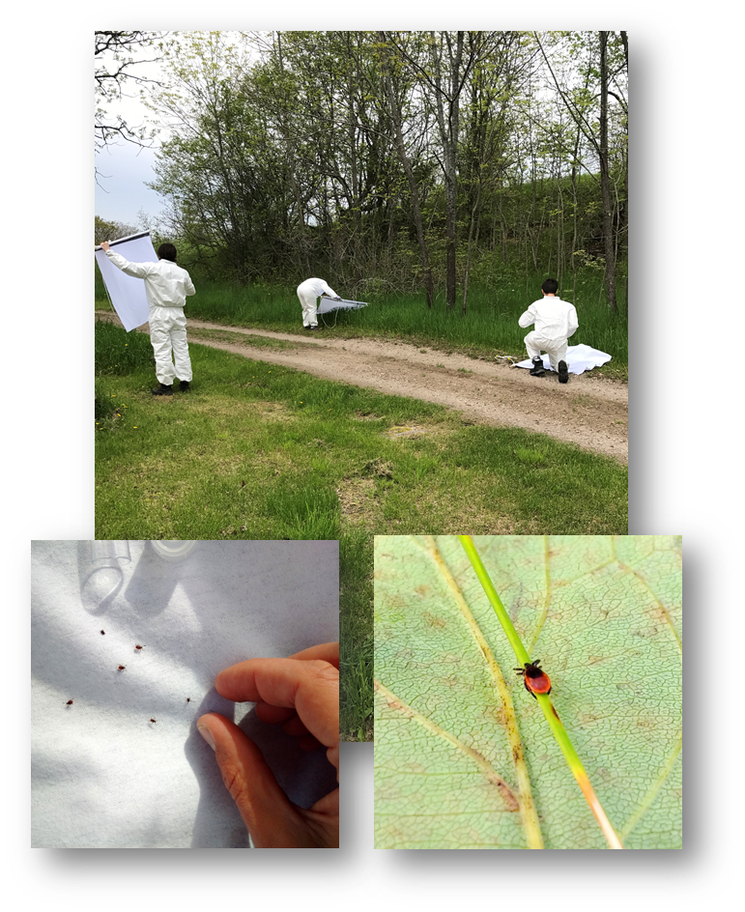
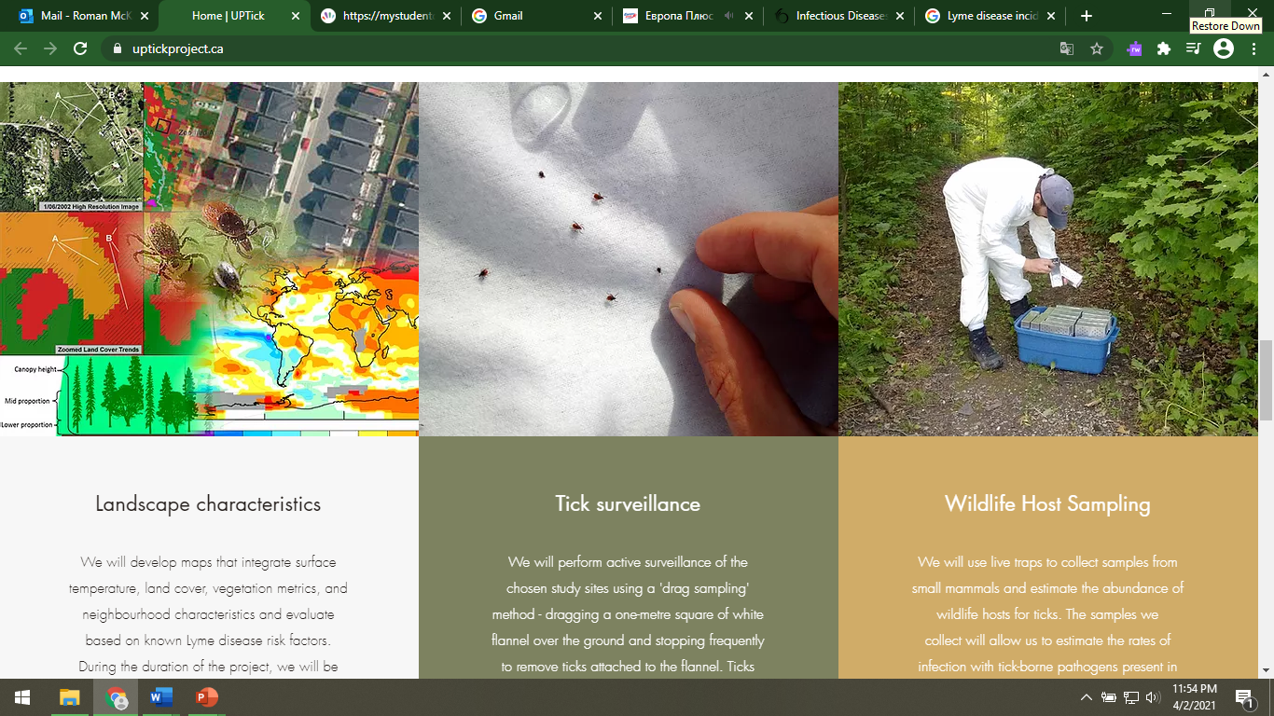
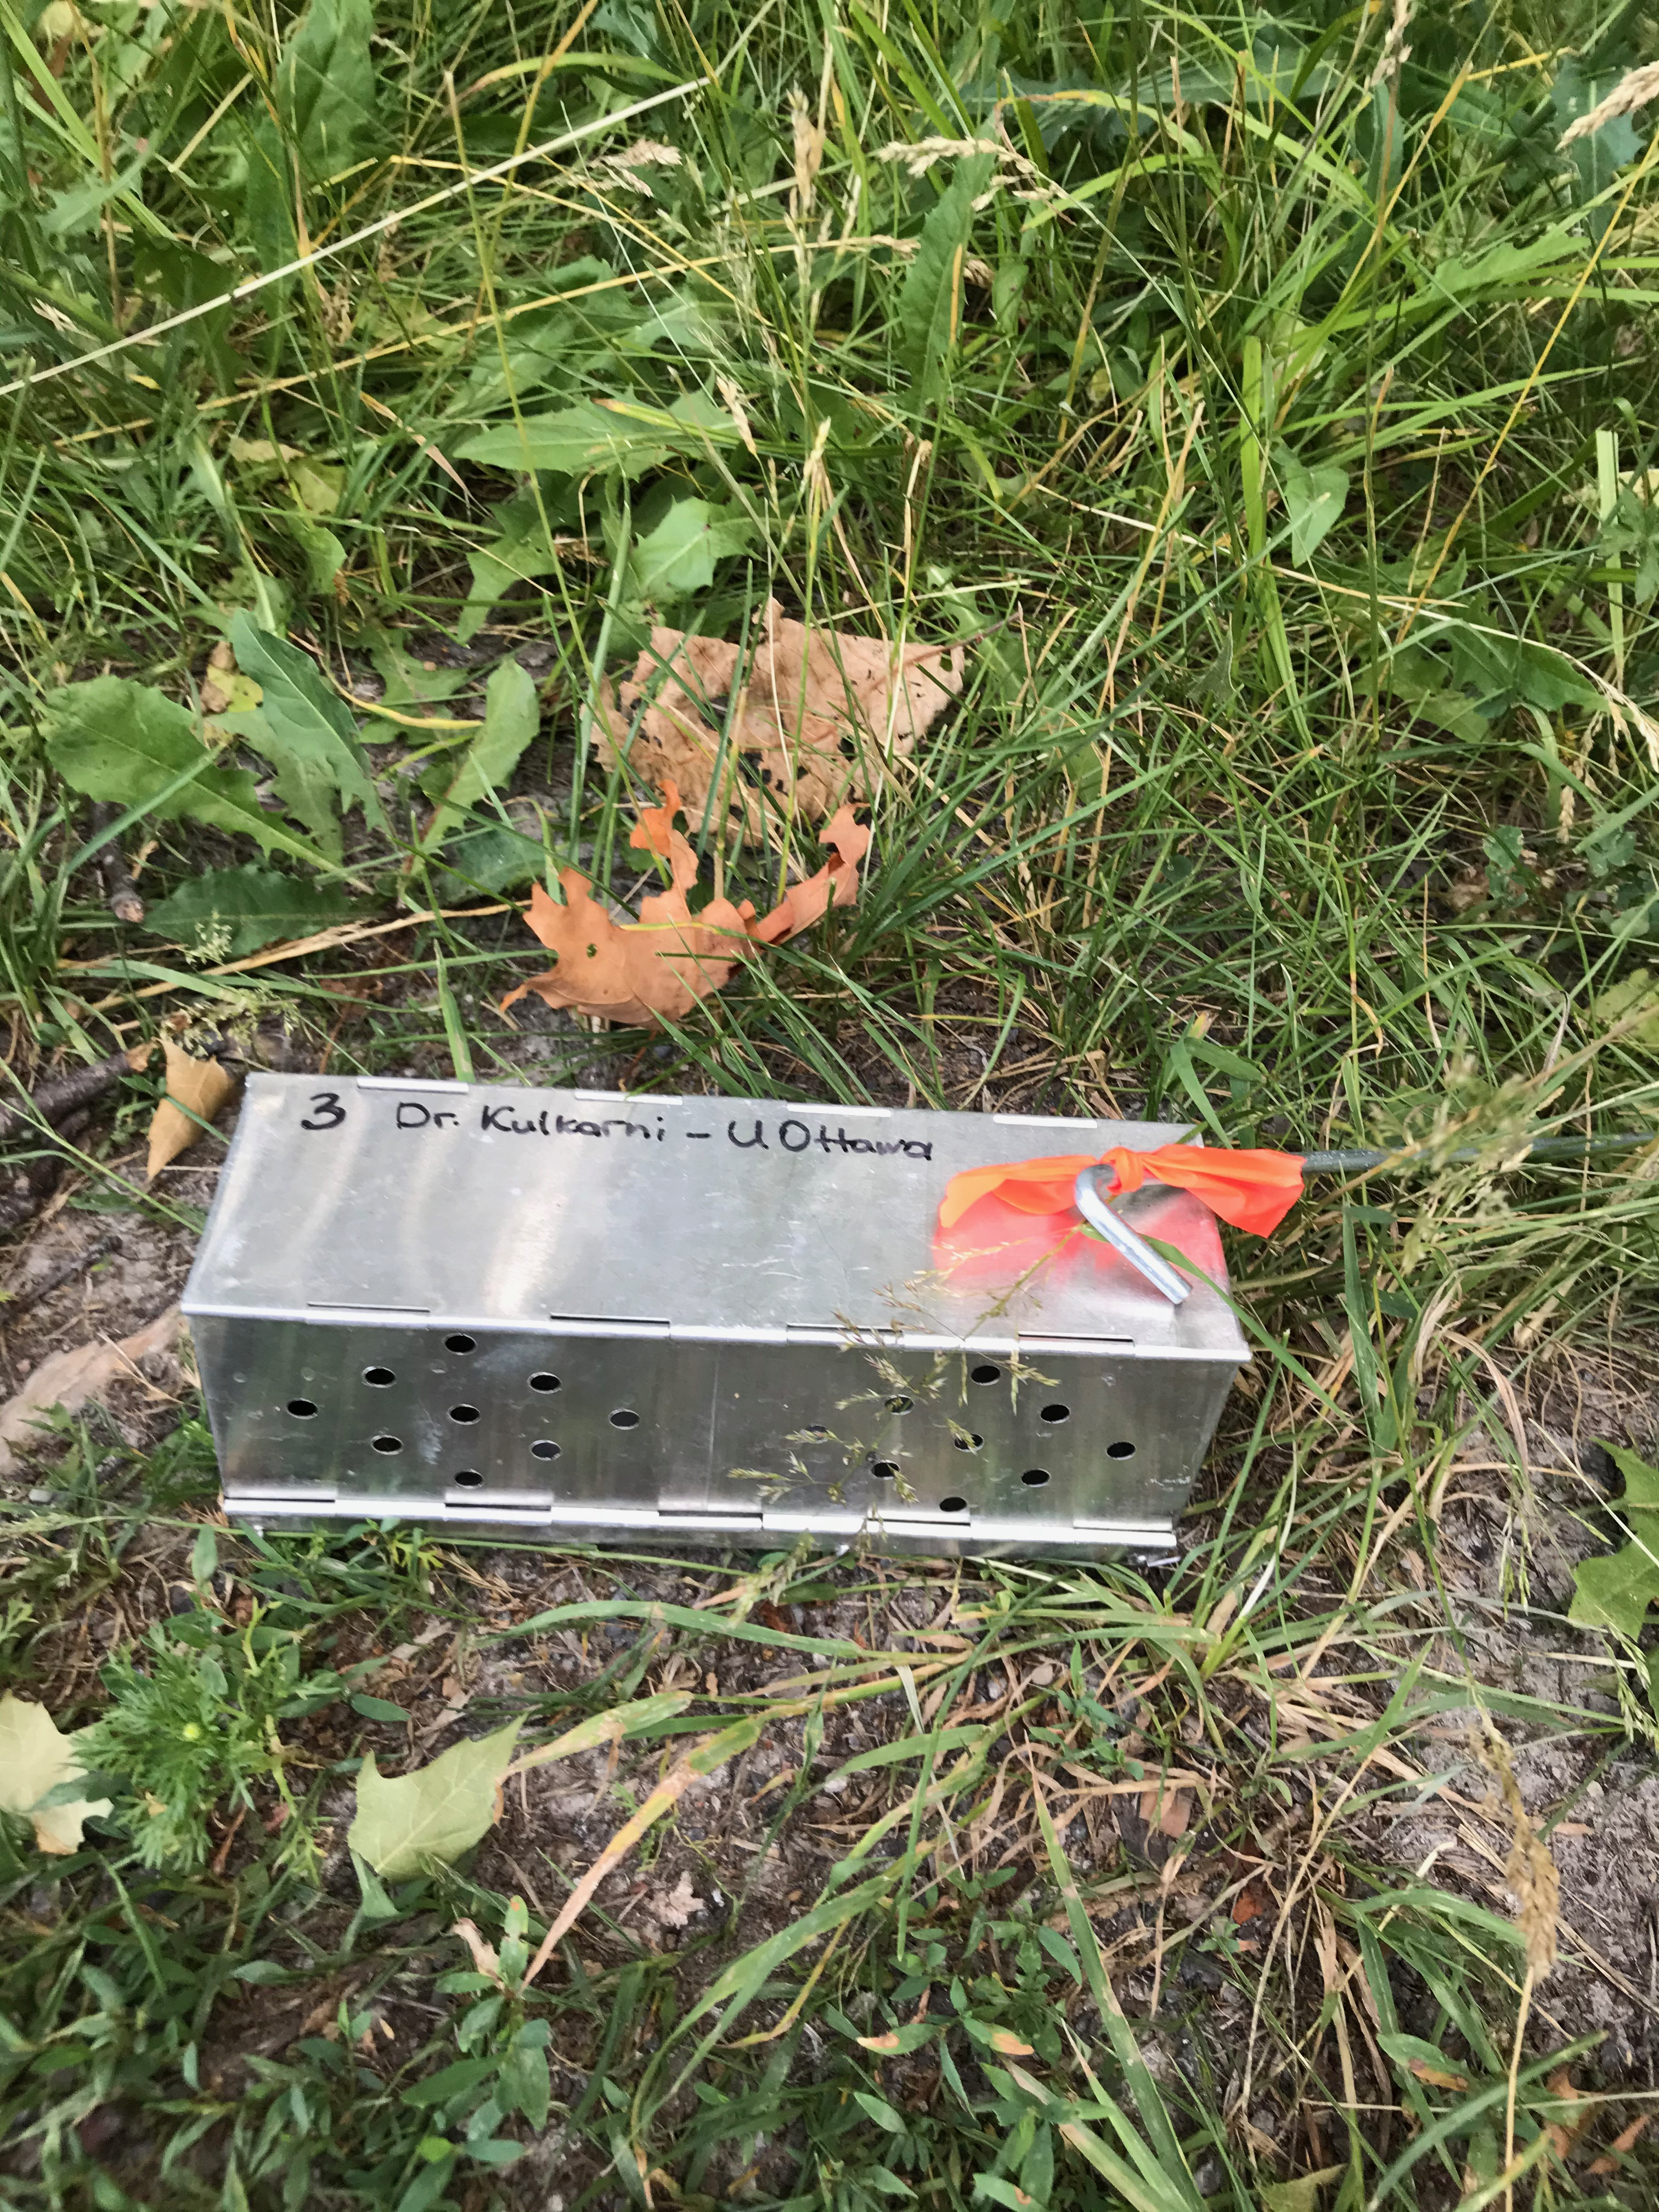
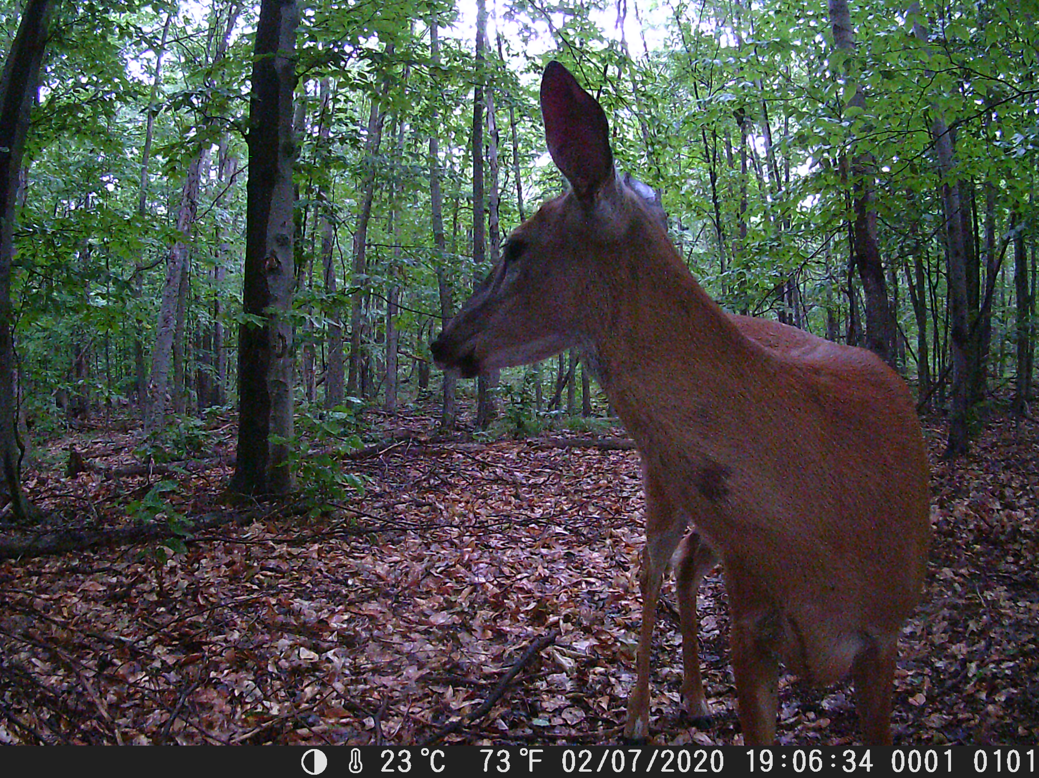
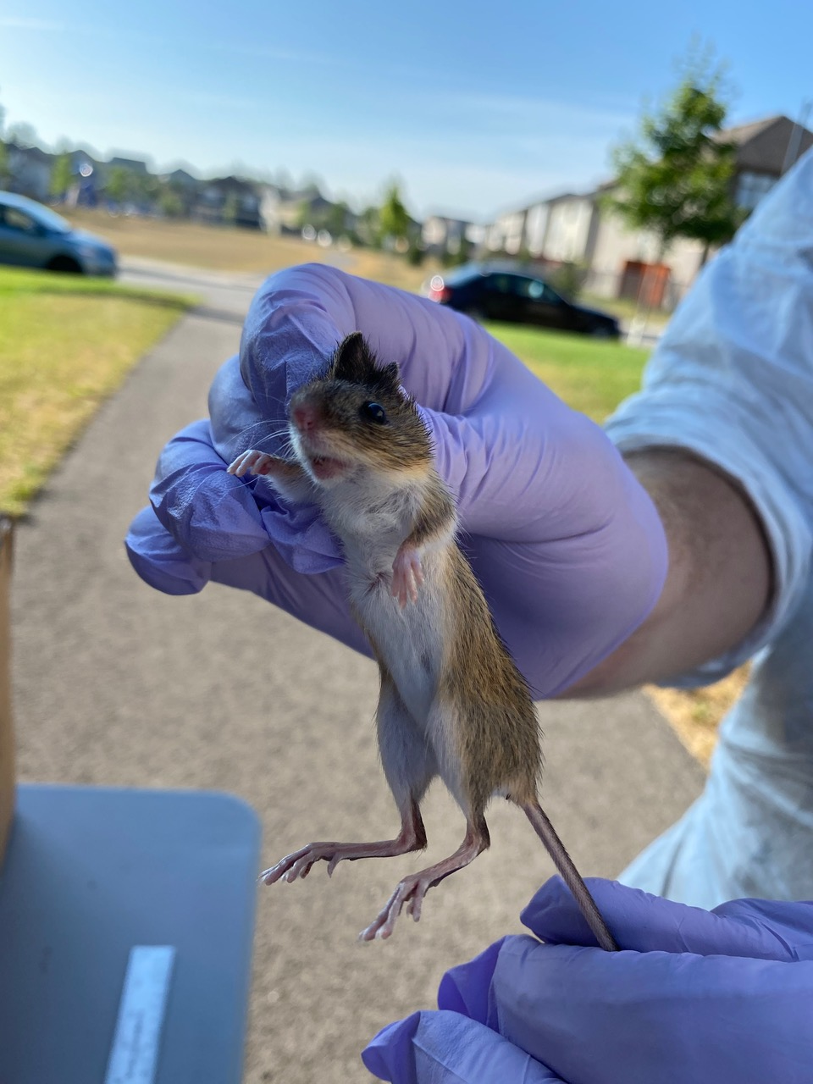
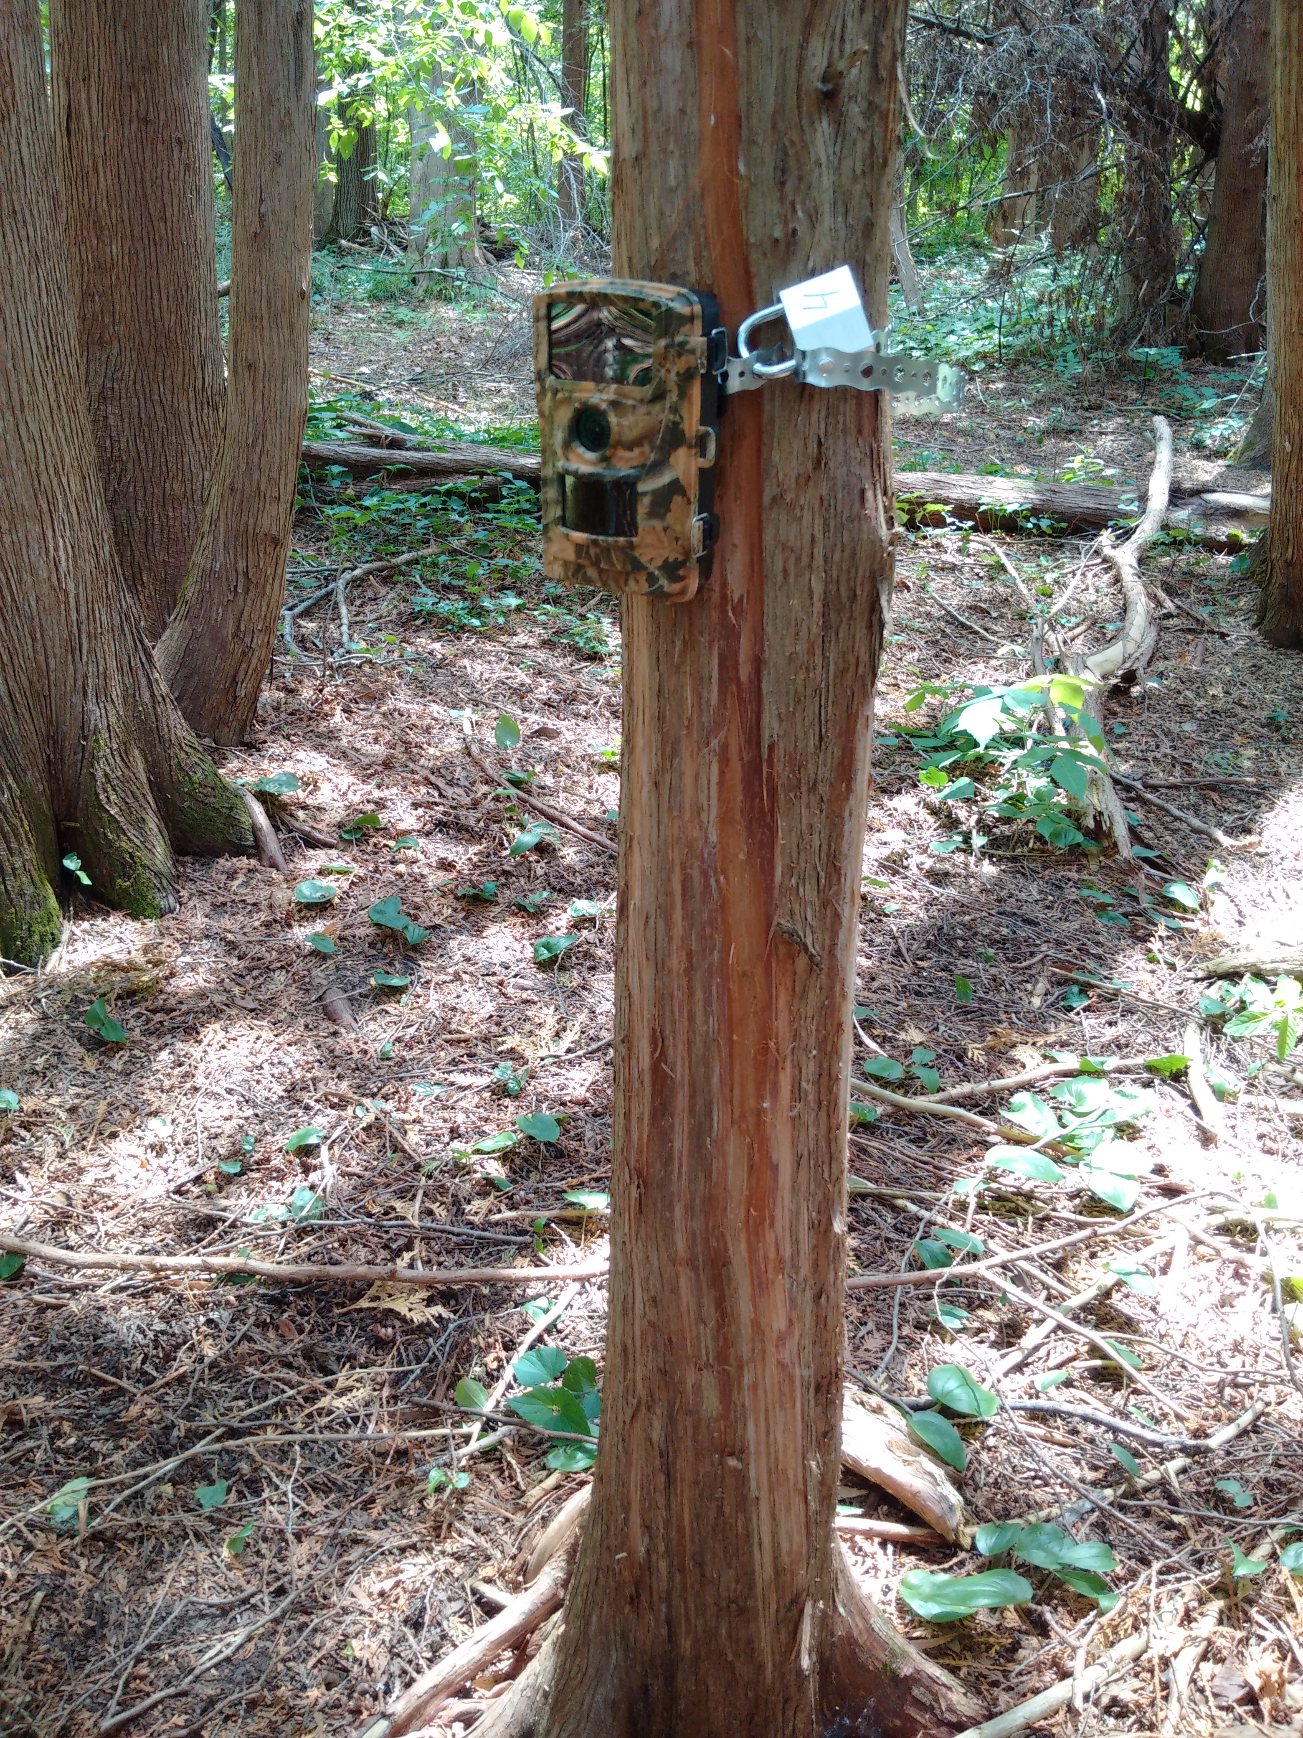
Activities
Field Monitoring
Tick surveillance
Wildlife host sampling
Deer surveillance
Notes:
At the provincial level -- Ontario…
PHO defines a Lyme disease risk area in Ontario based on active tick surveillance (ie conducting three person-hours of drag sampling of areas of concern between May and October), since finding at least one blacklegged tick (Ixodes scapularis) during this time period may indicate a possible risk area for Lyme disease.
The estimated risk areas are calculated as a 20 kilometer radius from the centre of a location where blacklegged ticks were found through drag sampling.
According to PHO this map of Lyme disease Risk Areas has been developed to assist clinicians in the diagnosis and/or treatment of Lyme disease, with potential exposures or tick bites in the risk areas delineated on the map leading to greater concern about the risks of Lyme disease. In addition, public health professionals can use the map to determine if reported case exposure locations represent known or possible new/emerging risk areas, thus helping to inform public health messages aiming to raise awareness of Lyme disease risk areas in Ontario.

Slide 12
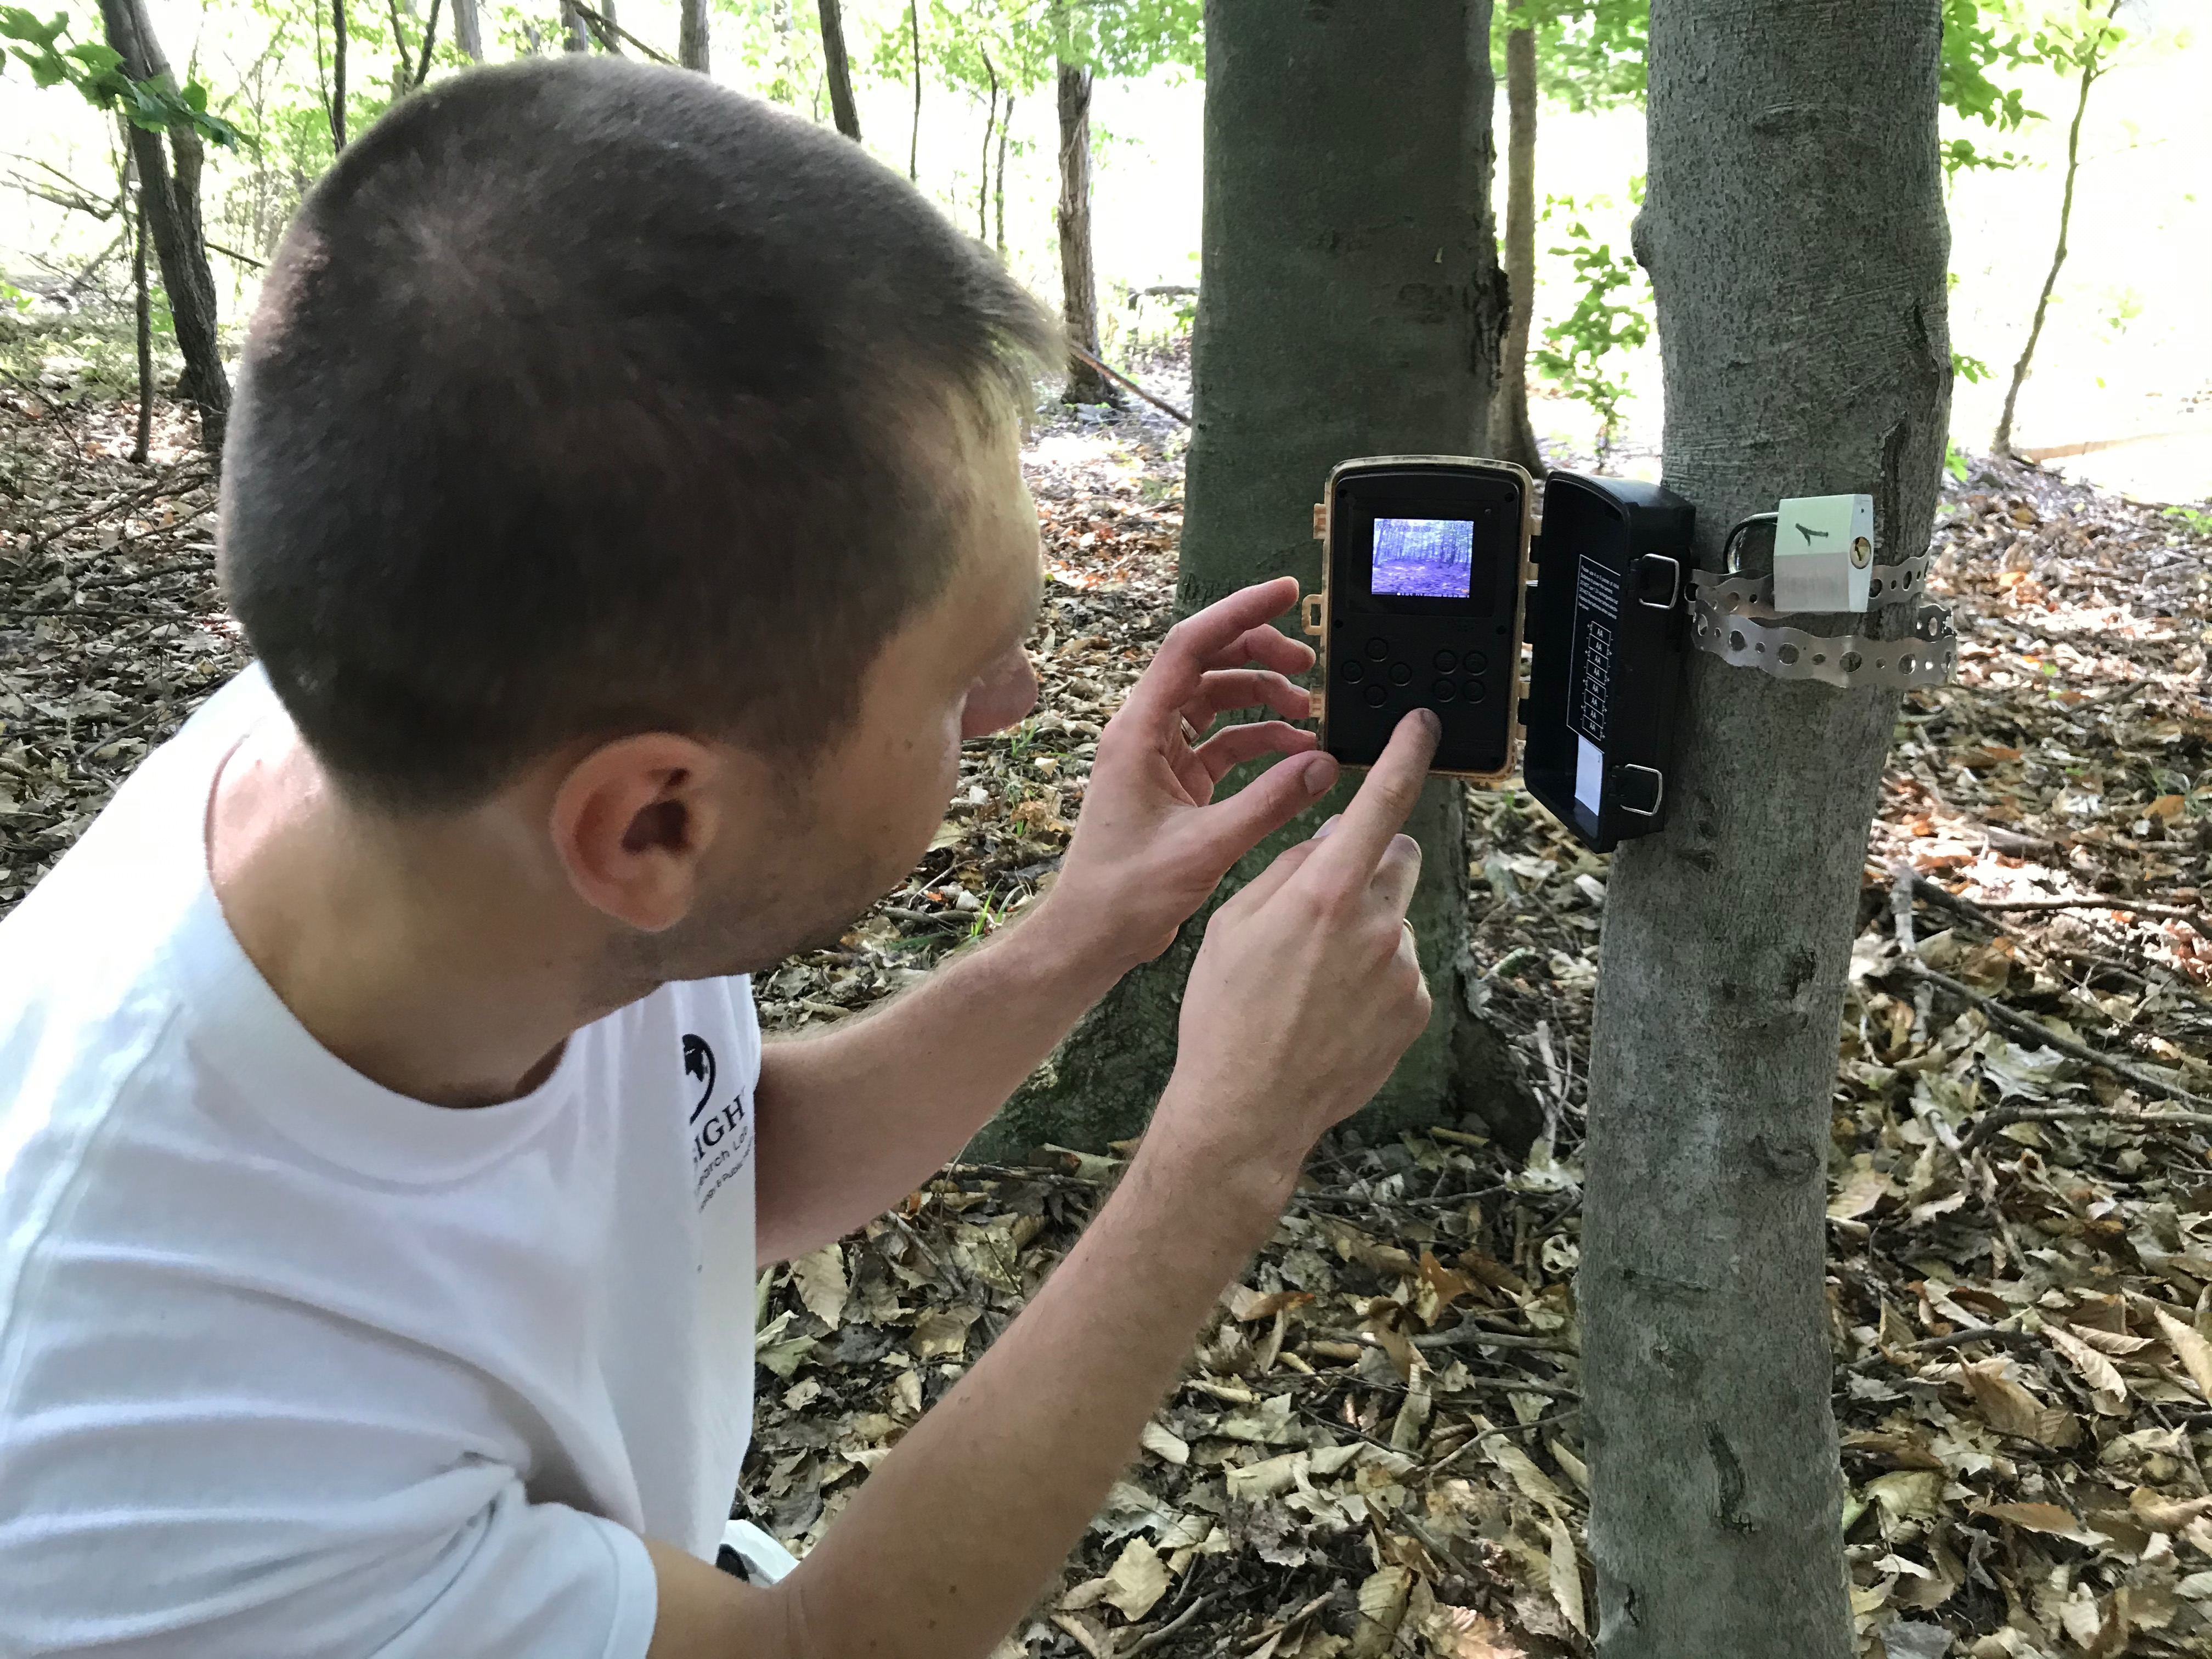
Activities
Field Monitoring
Tick surveillance
We perform active surveillance using a 'drag sampling' method - dragging a one-metre square of white flannel over the ground and stopping frequently to remove ticks attached to the flannel.
Wildlife host sampling
We use live traps to collect samples from small mammals and estimate the abundance of wildlife hosts for ticks. The samples (ear-punches) we collect will allow us to estimate the rates of infection with tick-borne pathogens present in the natural environment.
Deer surveillance
We use motion-activated trail cameras to collect photos that we analyze to measure the presence and occupancy of white-tailed deer in different environments. We will then relate these data to our measures of tick and small mammal population density and infection rates to help us understand the drivers of Lyme disease risk.
Notes:
At the provincial level -- Ontario…
PHO defines a Lyme disease risk area in Ontario based on active tick surveillance (ie conducting three person-hours of drag sampling of areas of concern between May and October), since finding at least one blacklegged tick (Ixodes scapularis) during this time period may indicate a possible risk area for Lyme disease.
The estimated risk areas are calculated as a 20 kilometer radius from the centre of a location where blacklegged ticks were found through drag sampling.
According to PHO this map of Lyme disease Risk Areas has been developed to assist clinicians in the diagnosis and/or treatment of Lyme disease, with potential exposures or tick bites in the risk areas delineated on the map leading to greater concern about the risks of Lyme disease. In addition, public health professionals can use the map to determine if reported case exposure locations represent known or possible new/emerging risk areas, thus helping to inform public health messages aiming to raise awareness of Lyme disease risk areas in Ontario.

Slide 13
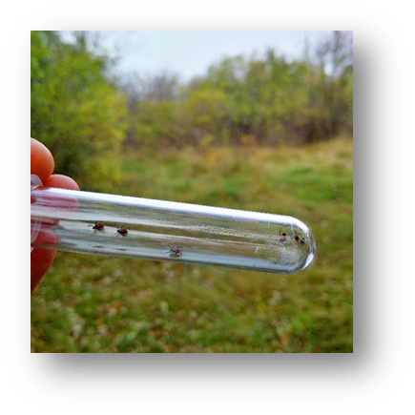
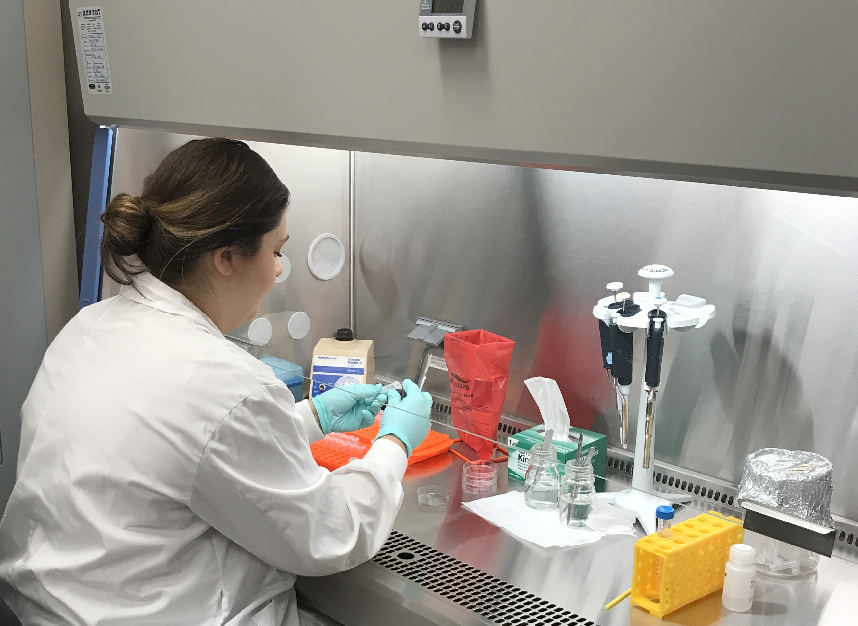
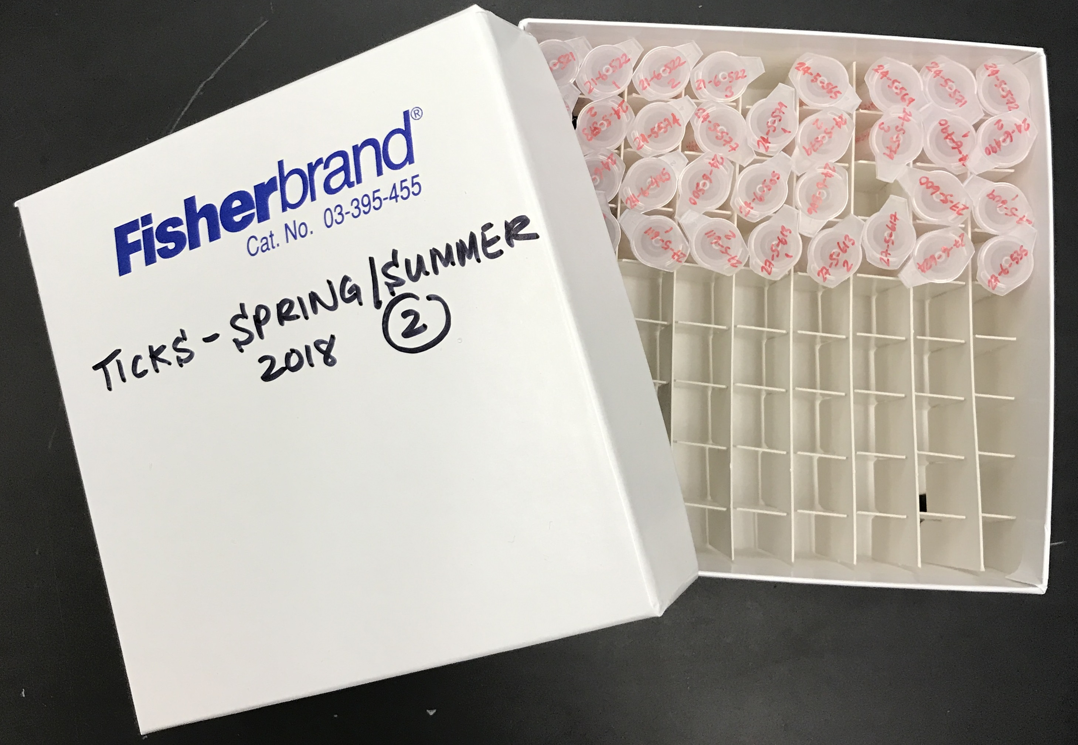
Lab activities
Transport to lab
Extract DNA and test
for pathogen genetic markers
Field samples
Collected ticks and ear-punches from mice are tested in our laboratory at the University of Ottawa using quantitative polymerase chain reaction (qPCR) assays for the detection of Borrelia burgdorferi and Borrelia miyamotoi (pathogens that causes Lyme disease and hard tick relapsing fever) and Anaplasma phagocytophilum (causes human granulocytic anaplasmosis).
© Manisha Kulkarni 2018

Slide 14
Preliminary Results
May-October 2020 Field Season

Slide 15
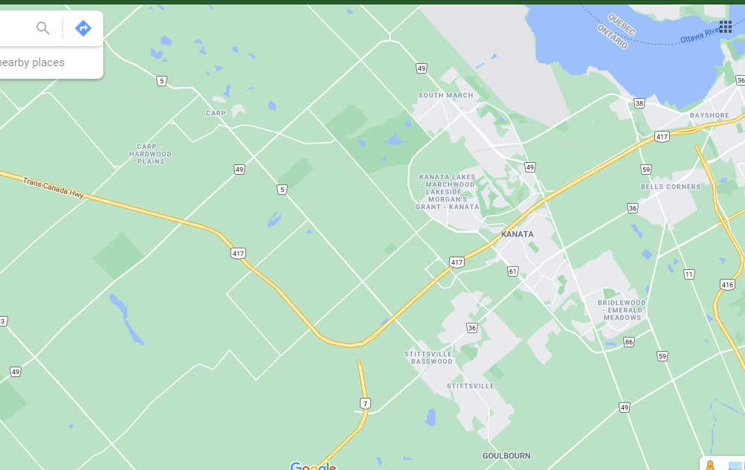
Mean number of blacklegged ticks collected per month in each neighborhood
Carp Hill
Blacklegged ticks were detected in all four study neighbourhoods
Kanata North
Stonehaven
Legend
Carp Hill – 0.3 ticks
Kanata North – 6.0 ticks
Stittsville
Stonehaven – 1.7 ticks
Stittsville – 1.3 ticks

Slide 16
Results of field activities
*total area of drag sampling per month in each neighbourhood is 1800 m²

Slide 17
Results of field and lab activities
*total area of drag sampling per month in each zone is 600 m²

Slide 18
Results of field and lab activities
*total sampling effort of 600 trap-nights per zone

Slide 19
Results of field and lab activities
In total 12 cameras collected approximately 37000 photos.
We have analyzed photos from trail cameras to measure the presence and occupancy of white-tailed deer in different environments.
The trail cameras have not collected any personal information and any photos inadvertently taken of people were erased.

Slide 20
Summary of Preliminary Results
Blacklegged ticks, rodent hosts, and the Lyme disease pathogen are present in all four study neighbourhoods
  Highest tick densities were found in Kanata North and Kanata South, while lower tick densities were found in Stittsville and Carp
  Within each neighbourhood, substantially higher numbers of ticks were found in the woodland and interface zones, with infection rates ~30%
    Very few to no ticks were found within residential zones, and none were infected
  In general, higher numbers of mice were found in residential zones, but infected mice were mainly limited to woodland and interface zones
Preliminary results indicate that Lyme disease transmission between ticks and mice is mainly occurring in the woodland and interface zones within neighbourhoods
  Trails and pathways in these zones may pose a risk of Lyme disease exposure to people

Slide 21
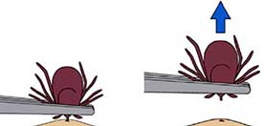
How can you prevent a tick bite?
Wear long pants, a long sleeved shirt, shoes and socks to cover exposed skin
If possible, stay on the trails when hiking in the woods or walking in long grass
Apply an approved insect repellent containing DEET or icaridin
Do a "full body" check on yourself, your children, and pets for ticks
Remove ticks as soon as possible
Notes:
If you find a tick on your body, using fine-pointed tweezers, grasp the tick's head as close to the skin as possible and pull slowly until the tick is removed. Do not twist or rotate the tick. Do not use a match, lotion or anything else on the tick.

Slide 22
How can you reduce ticks around your home?
Keep the grass in your yard mowed
Remove brush and fallen leaves from the edges of your property
Clean up areas under and around bird feeders
Discourage deer from entering your yard
Use a 1-metre barrier of woodchips or rock to separate woods from lawn
From: Stafford K. (2004) Tick Management Handbook. Connecticut Agricultural Experiment Station.

Slide 23


Acknowledgements
Kulkarni (INSIGHT) Lab, uOttawa | www.globalhealthepi.com,
www.uptickproject.ca
Researchers:
Dr. Manisha Kulkarni, Dr. Benoit Talbot, Dr. Roman McKay, Andreea Slatculescu (PhD cand.), Jay Logan (PhD cand.), Charles Thickstun (PhD cand.), Claudia Duguay (PhD cand.), Holly Burrows (MPH cand.), INSIGHT Lab, uOttawa
Dr. Anders Knudby, Remote Sensing Lab, uOttawa
Dr. Patrick Leighton, University of Montreal
Stakeholders:
Nick Stow, Coun. Glen Gower, Coun. Eli El-Chantiry, Coun. Jenna Sudds, Coun. Allan Hubley, City of Ottawa
Eva Katic & Alexander Stone, National Capital Commission
Janet Mason, Friends of Carp Hill

Slide 24
Thank you for your attention!

Slide 25
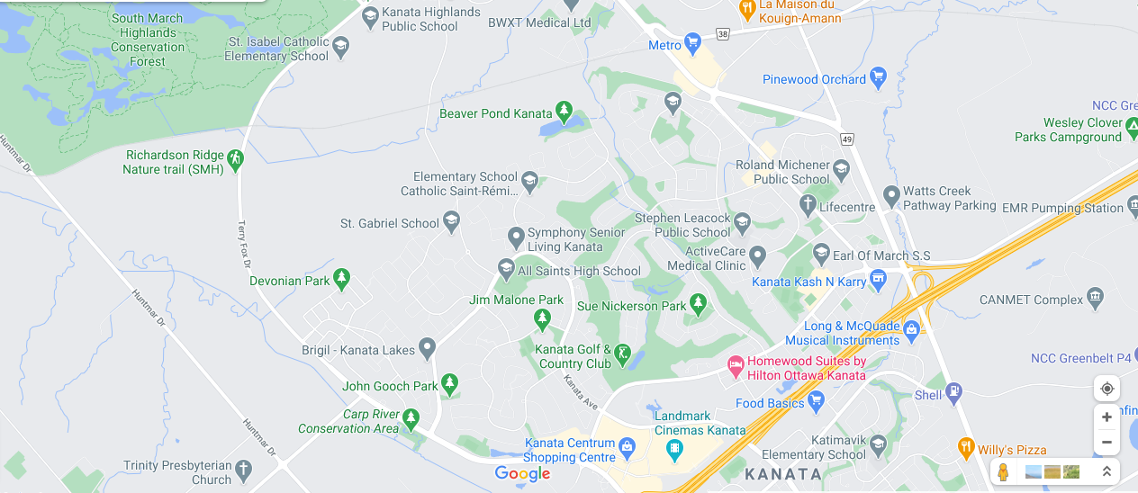
Map: Kanata North (Kizell Pond): Red dotted outline natural wooded zones, Blue - established residential/woodland interface, Yellow - within-neighbourhood residential yards and trails.
Notes:
At the provincial level -- Ontario…
PHO defines a Lyme disease risk area in Ontario based on active tick surveillance (ie conducting three person-hours of drag sampling of areas of concern between May and October), since finding at least one blacklegged tick (Ixodes scapularis) during this time period may indicate a possible risk area for Lyme disease.
The estimated risk areas are calculated as a 20 kilometer radius from the centre of a location where blacklegged ticks were found through drag sampling.
According to PHO this map of Lyme disease Risk Areas has been developed to assist clinicians in the diagnosis and/or treatment of Lyme disease, with potential exposures or tick bites in the risk areas delineated on the map leading to greater concern about the risks of Lyme disease. In addition, public health professionals can use the map to determine if reported case exposure locations represent known or possible new/emerging risk areas, thus helping to inform public health messages aiming to raise awareness of Lyme disease risk areas in Ontario.

Slide 26
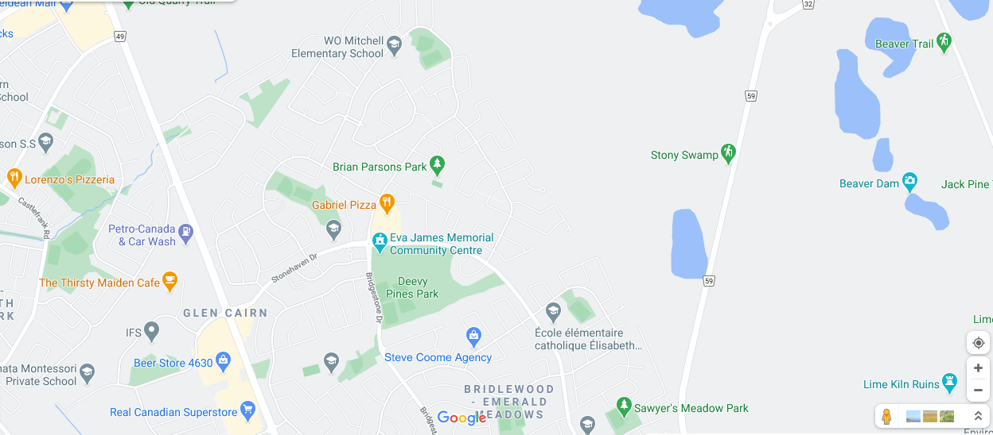
Map: Kanata South (Stonehaven neighborhood): Red dotted outline natural wooded zones, Blue - established residential/woodland interface, Yellow - within-neighbourhood residential yards and trails.
Notes:
At the provincial level -- Ontario…
PHO defines a Lyme disease risk area in Ontario based on active tick surveillance (ie conducting three person-hours of drag sampling of areas of concern between May and October), since finding at least one blacklegged tick (Ixodes scapularis) during this time period may indicate a possible risk area for Lyme disease.
The estimated risk areas are calculated as a 20 kilometer radius from the centre of a location where blacklegged ticks were found through drag sampling.
According to PHO this map of Lyme disease Risk Areas has been developed to assist clinicians in the diagnosis and/or treatment of Lyme disease, with potential exposures or tick bites in the risk areas delineated on the map leading to greater concern about the risks of Lyme disease. In addition, public health professionals can use the map to determine if reported case exposure locations represent known or possible new/emerging risk areas, thus helping to inform public health messages aiming to raise awareness of Lyme disease risk areas in Ontario.

Slide 27
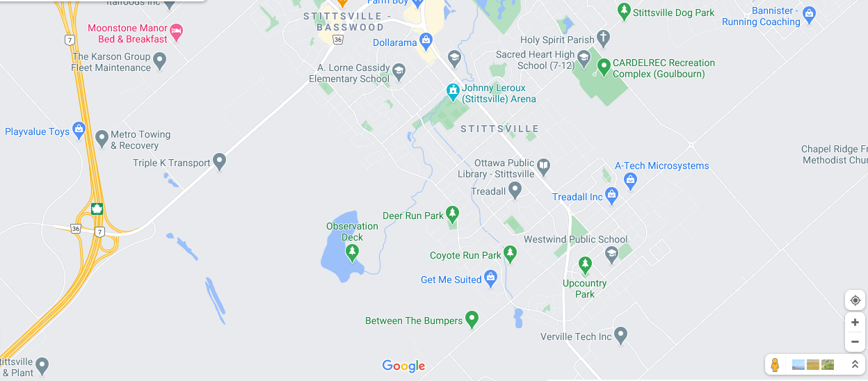
Map Stittsville – Upper Poole Creek corridor: Red dotted outline natural wooded zones, Blue dotted - established residential/woodland interface, Yellow dotted - within-neighbourhood residential yards and trails.
Notes:
At the provincial level -- Ontario…
PHO defines a Lyme disease risk area in Ontario based on active tick surveillance (ie conducting three person-hours of drag sampling of areas of concern between May and October), since finding at least one blacklegged tick (Ixodes scapularis) during this time period may indicate a possible risk area for Lyme disease.
The estimated risk areas are calculated as a 20 kilometer radius from the centre of a location where blacklegged ticks were found through drag sampling.
According to PHO this map of Lyme disease Risk Areas has been developed to assist clinicians in the diagnosis and/or treatment of Lyme disease, with potential exposures or tick bites in the risk areas delineated on the map leading to greater concern about the risks of Lyme disease. In addition, public health professionals can use the map to determine if reported case exposure locations represent known or possible new/emerging risk areas, thus helping to inform public health messages aiming to raise awareness of Lyme disease risk areas in Ontario.

Slide 28
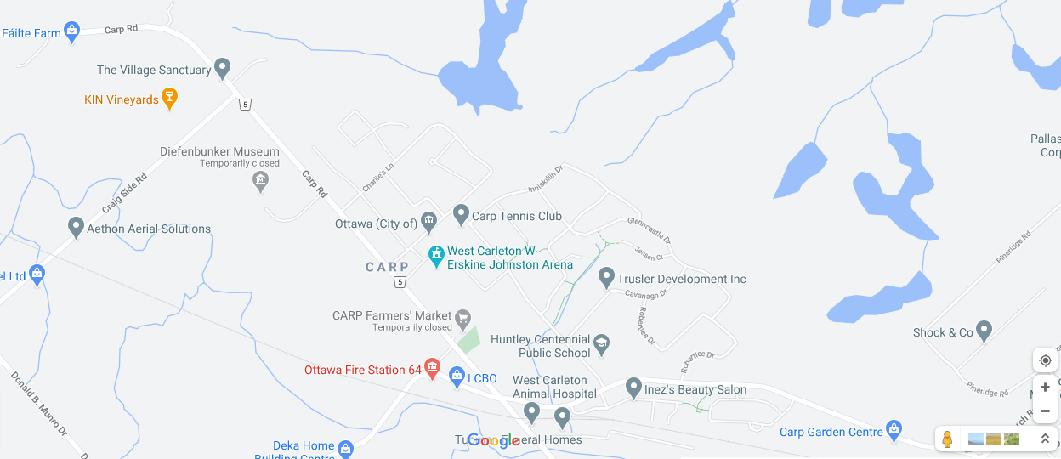
Map Carp Hill (Wetland Complex): Red dotted outline natural wooded zones, Blue - established residential/woodland interface, Yellow - within-neighbourhood residential yards and trails.
Notes:
At the provincial level -- Ontario…
PHO defines a Lyme disease risk area in Ontario based on active tick surveillance (ie conducting three person-hours of drag sampling of areas of concern between May and October), since finding at least one blacklegged tick (Ixodes scapularis) during this time period may indicate a possible risk area for Lyme disease.
The estimated risk areas are calculated as a 20 kilometer radius from the centre of a location where blacklegged ticks were found through drag sampling.
According to PHO this map of Lyme disease Risk Areas has been developed to assist clinicians in the diagnosis and/or treatment of Lyme disease, with potential exposures or tick bites in the risk areas delineated on the map leading to greater concern about the risks of Lyme disease. In addition, public health professionals can use the map to determine if reported case exposure locations represent known or possible new/emerging risk areas, thus helping to inform public health messages aiming to raise awareness of Lyme disease risk areas in Ontario.

